Slide 1
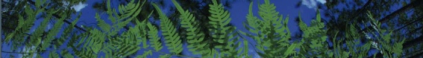



Applications of Niche Modeling
Makenzie Mabry
University of Florida
BiotaPhy

Slide 2
Ecological Niche
Fundamental Niche
abiotic conditions a species could potentially occupy in the absence of biotic interactions
Realized Niche
abiotic conditions that a species can occupy with the presence of biotic interactions
Fundamental
Niche
Precipitation
Realized
Niche
Temperature

Slide 3
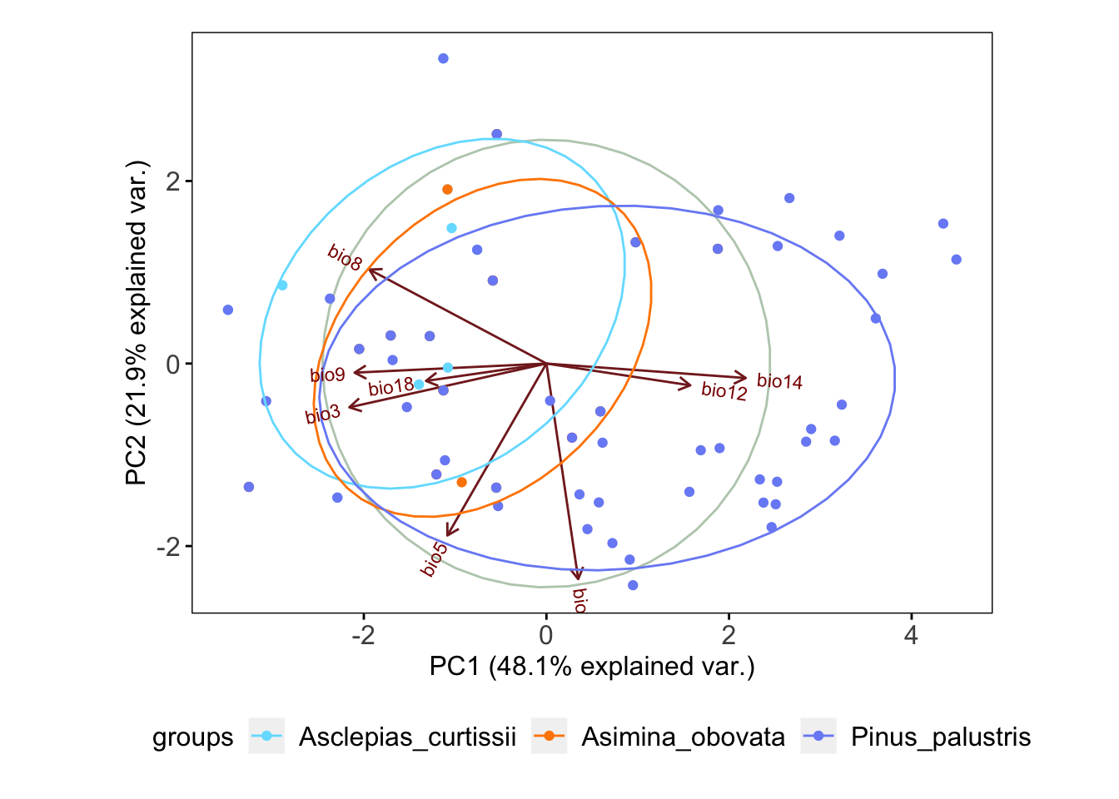
Ecological Niche
Fundamental Niche
abiotic conditions a species could potentially occupy in the absence of biotic interactions
“it is defined in multidimensional ecological space (MacArthur 1972).” – Peterson 2001

Slide 4
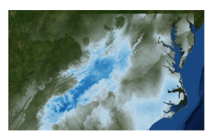
Ecological Niche Modeling
MaxEnt
uses the principle of maximum entropy on presence-only data to predict the species’ potential geographic distribution (or niche)
Figure from Gaynor et al. 2018

Slide 5
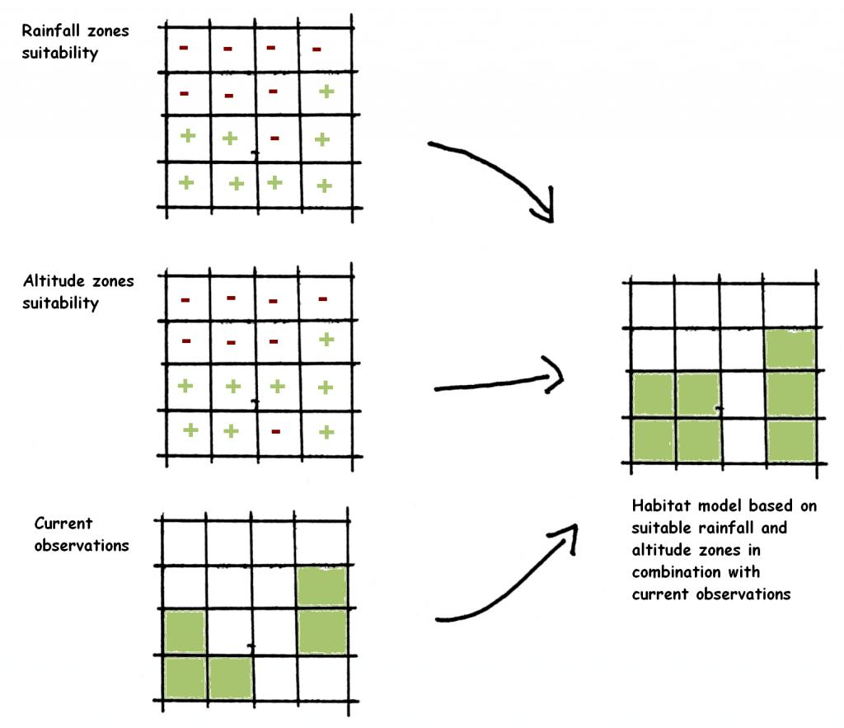
Environmental data
wikipedia

Slide 6
Environmental data
wikipedia

Slide 7
Environmental data
wikipedia
wikipedia

Slide 8
Environmental data
wikipedia
wikipedia

Slide 9
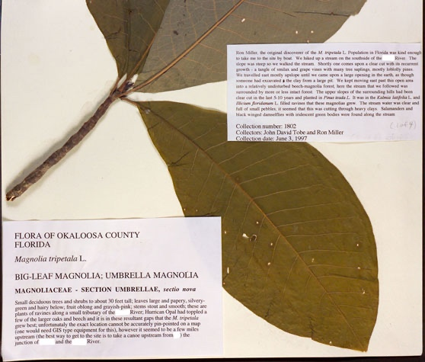
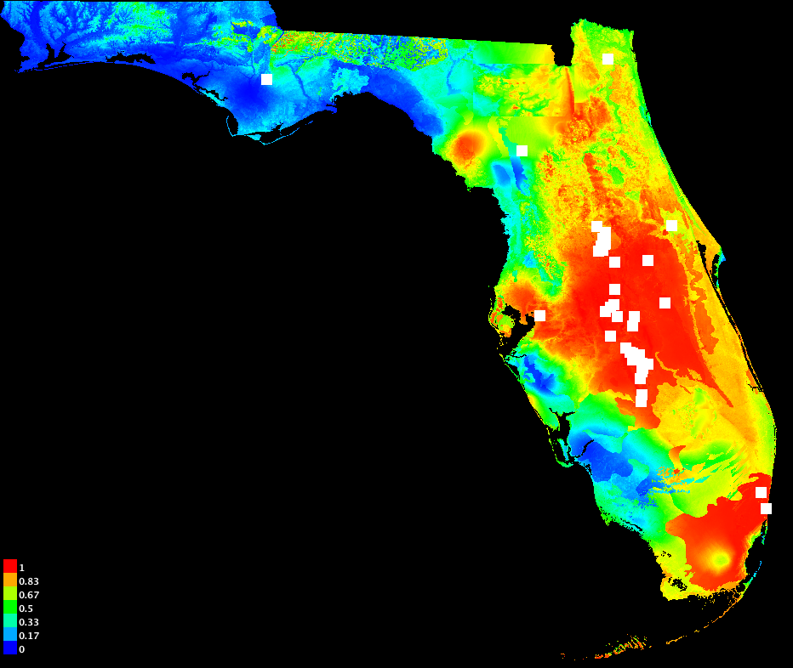
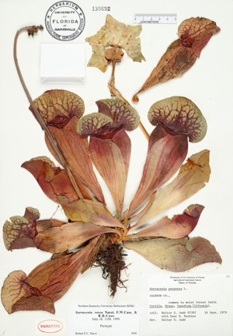
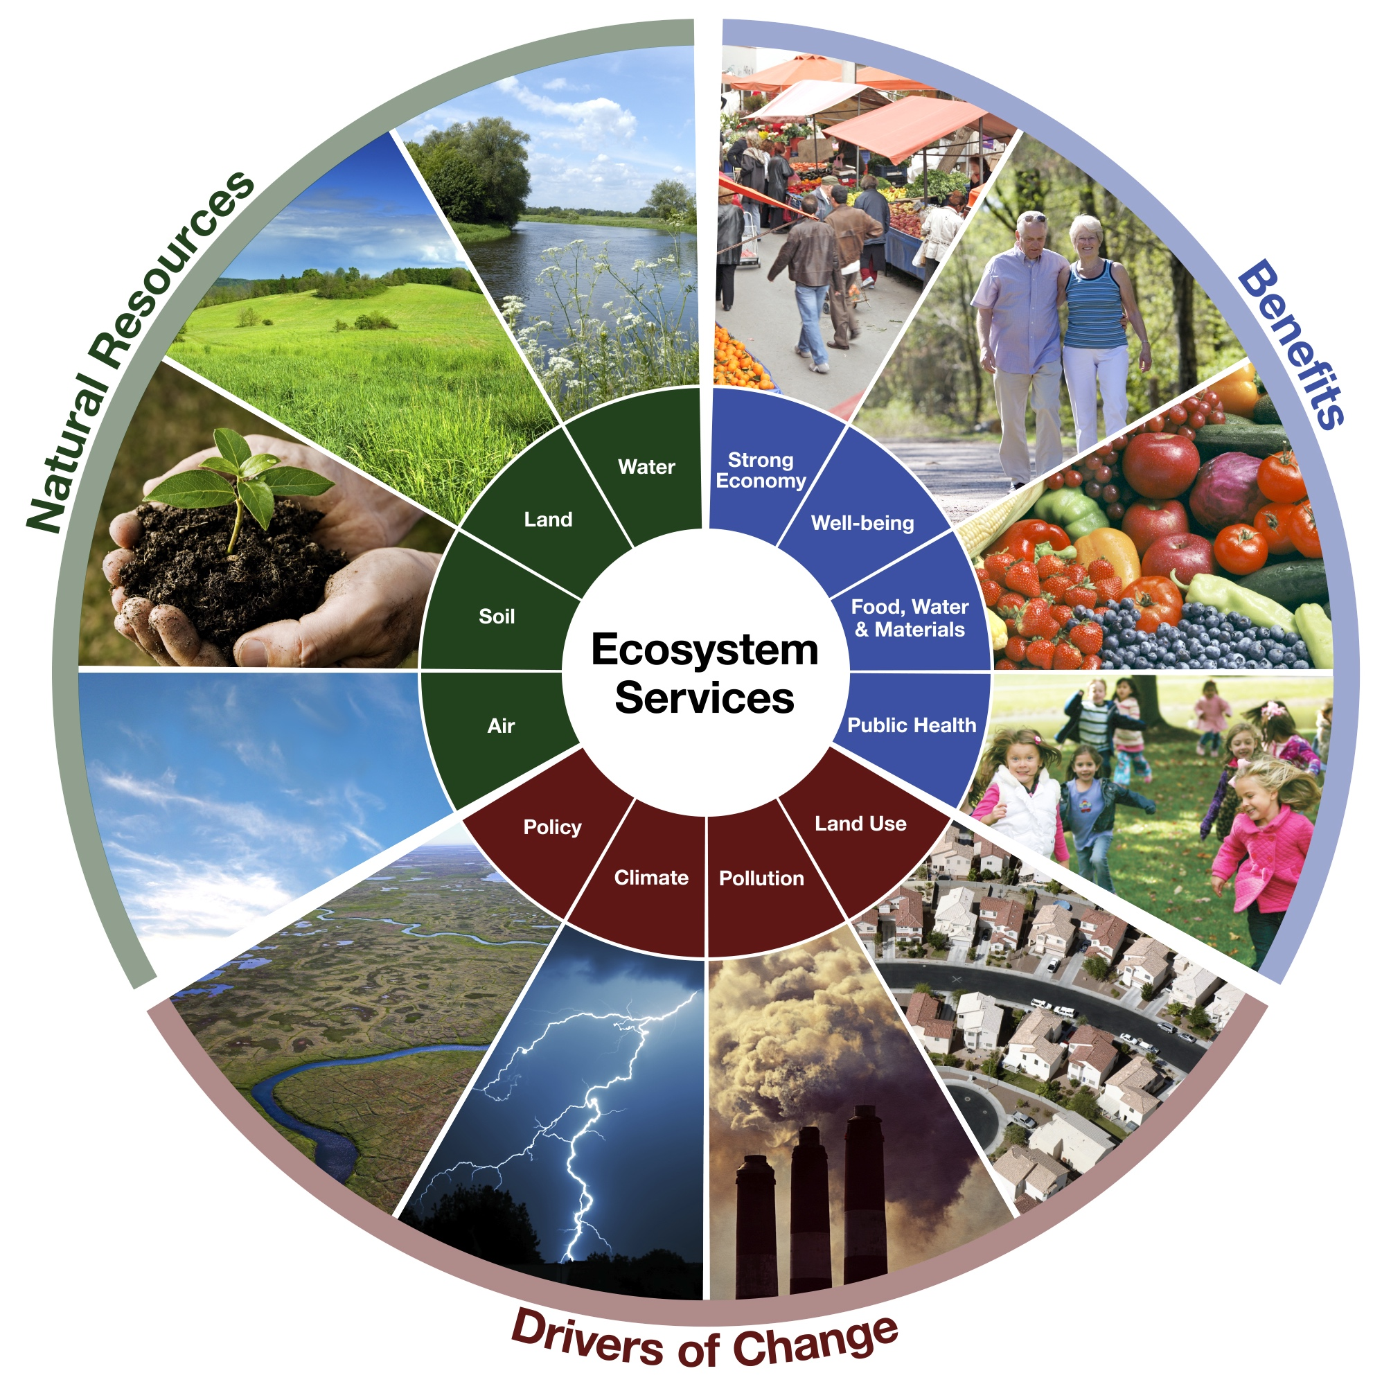
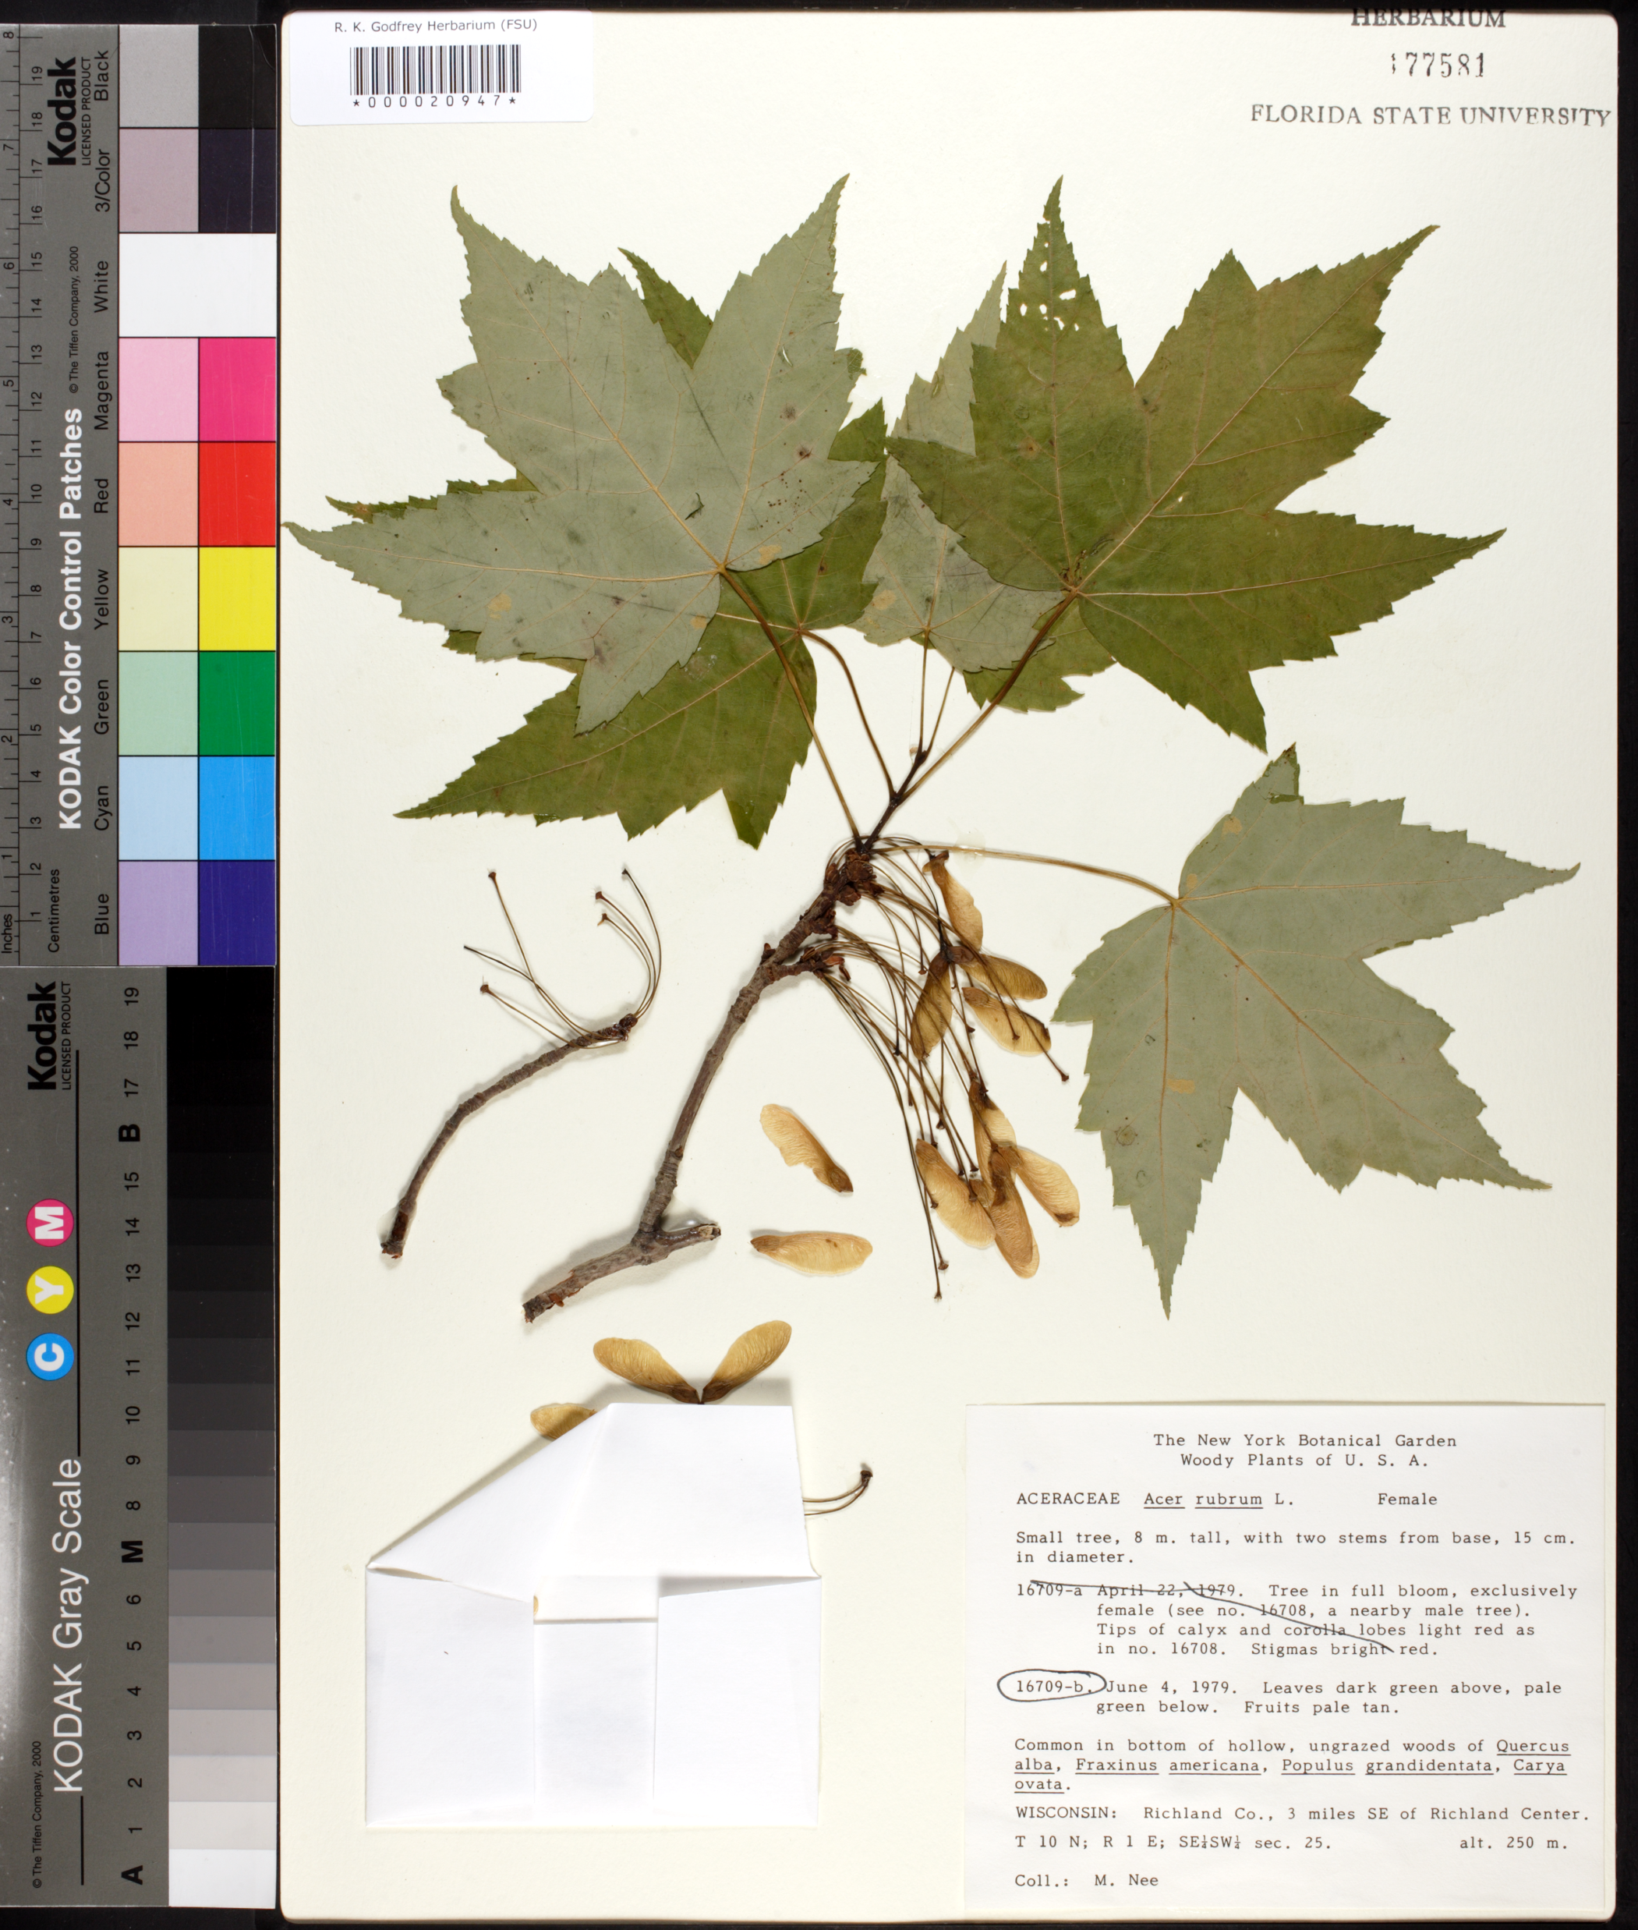
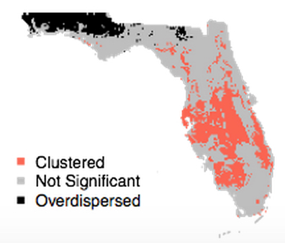
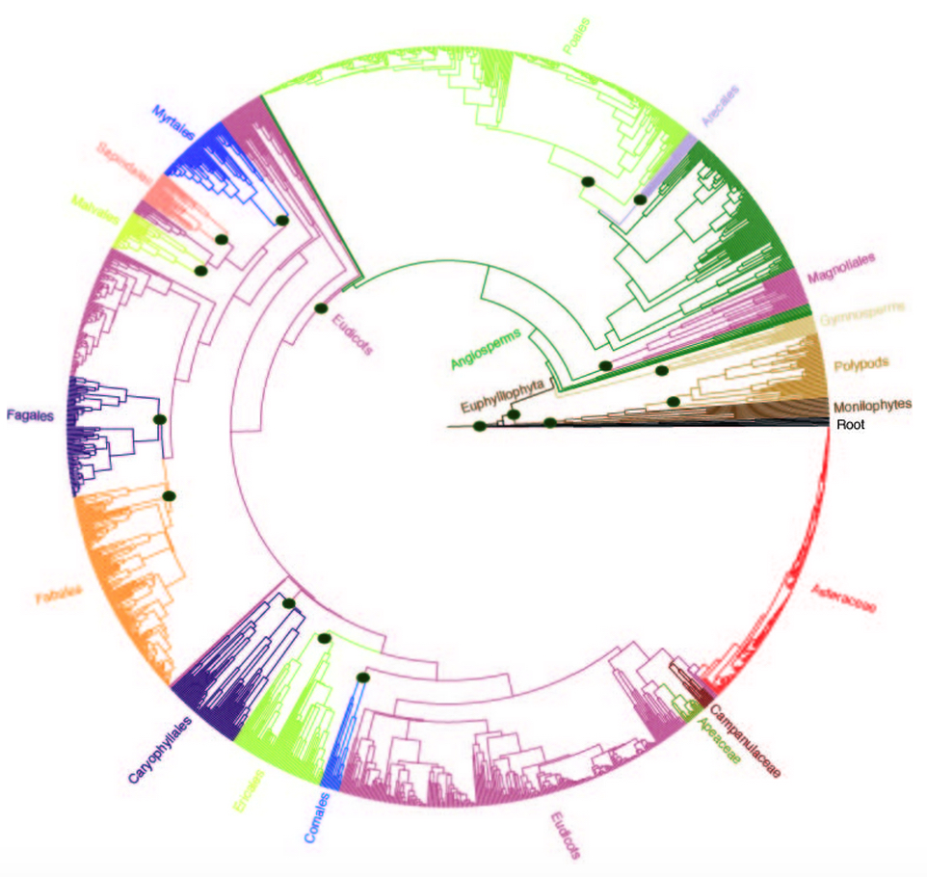
Applications of Ecological Niche Modeling
Notes:
Thanks to the support of NSF, more and more US collections are going online. UF is now home to iDigBio, the national center for digitization of biodiversity collections, which has the mission of coordinating digitization and databasing of US collections. iDigBio ingests, serves, and integrates data, such as locality information, date of collection, and images, from all natural history collections in the country.

Slide 10
Applications of Ecological Niche Models
Estimate current distribution
Predict future distributions
Infer past distributions
Use as foundation for phylogenetic diversity studies
Niche of polyploid compared to its diploid progenitor(s)
Invasives--projections
Allen, J., Folk, R.A., P.S. Soltis, D.E. Soltis, R.P. Guralnick. 2019. Biodiversity synthesis across the green branches of the tree of life. Nature Plants 5:11-13.
Notes:
Let’s briefly review some of the applications of niche modeling. Highlighting the items here

Slide 11
Applications of Ecological Niche Models
Estimate current distribution
Predict future distributions
Infer past distributions
Use as foundation for phylogenetic diversity studies
Niche of polyploid compared to its diploid progenitor(s)
Invasives--projections
Notes:
Let’s briefly review some of the applications of niche modeling. Highlighting the items here

Slide 12
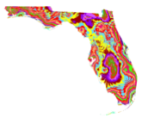
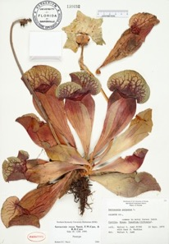


Florida Plant Diversity in a Changing Climate: Present & Future
Julie Allen, Charlotte Germain-Aubrey,
K. Neubig, L. Majure, R. Abbott, M. Whitten, N. Barve, H. Owens,
B. Mishler, S. Laffan, R. Guralnick, D. Soltis, P. Soltis
Rob Guralnick
Allen, Germain-Aubrey et al. 2019. iScience11: 57–70 https://doi.org/10.1016/ j.isci.2018.12.002
.
Julie Allen
Notes:
We have been studying vascular plant diversity in Florida combining herbarium records, niche models together with a phylogeny we constructed for these vascular plants. Kudos to…

Slide 13
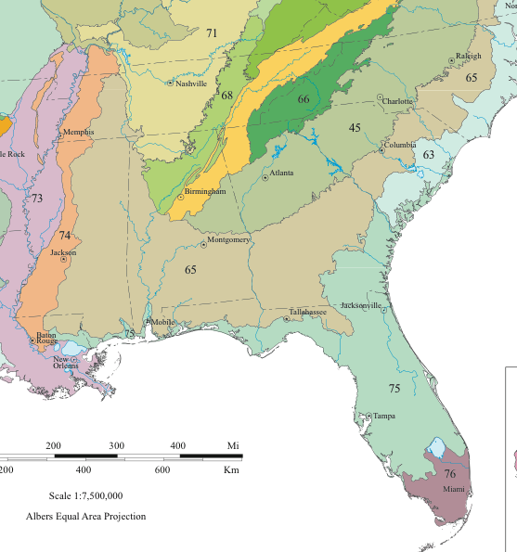
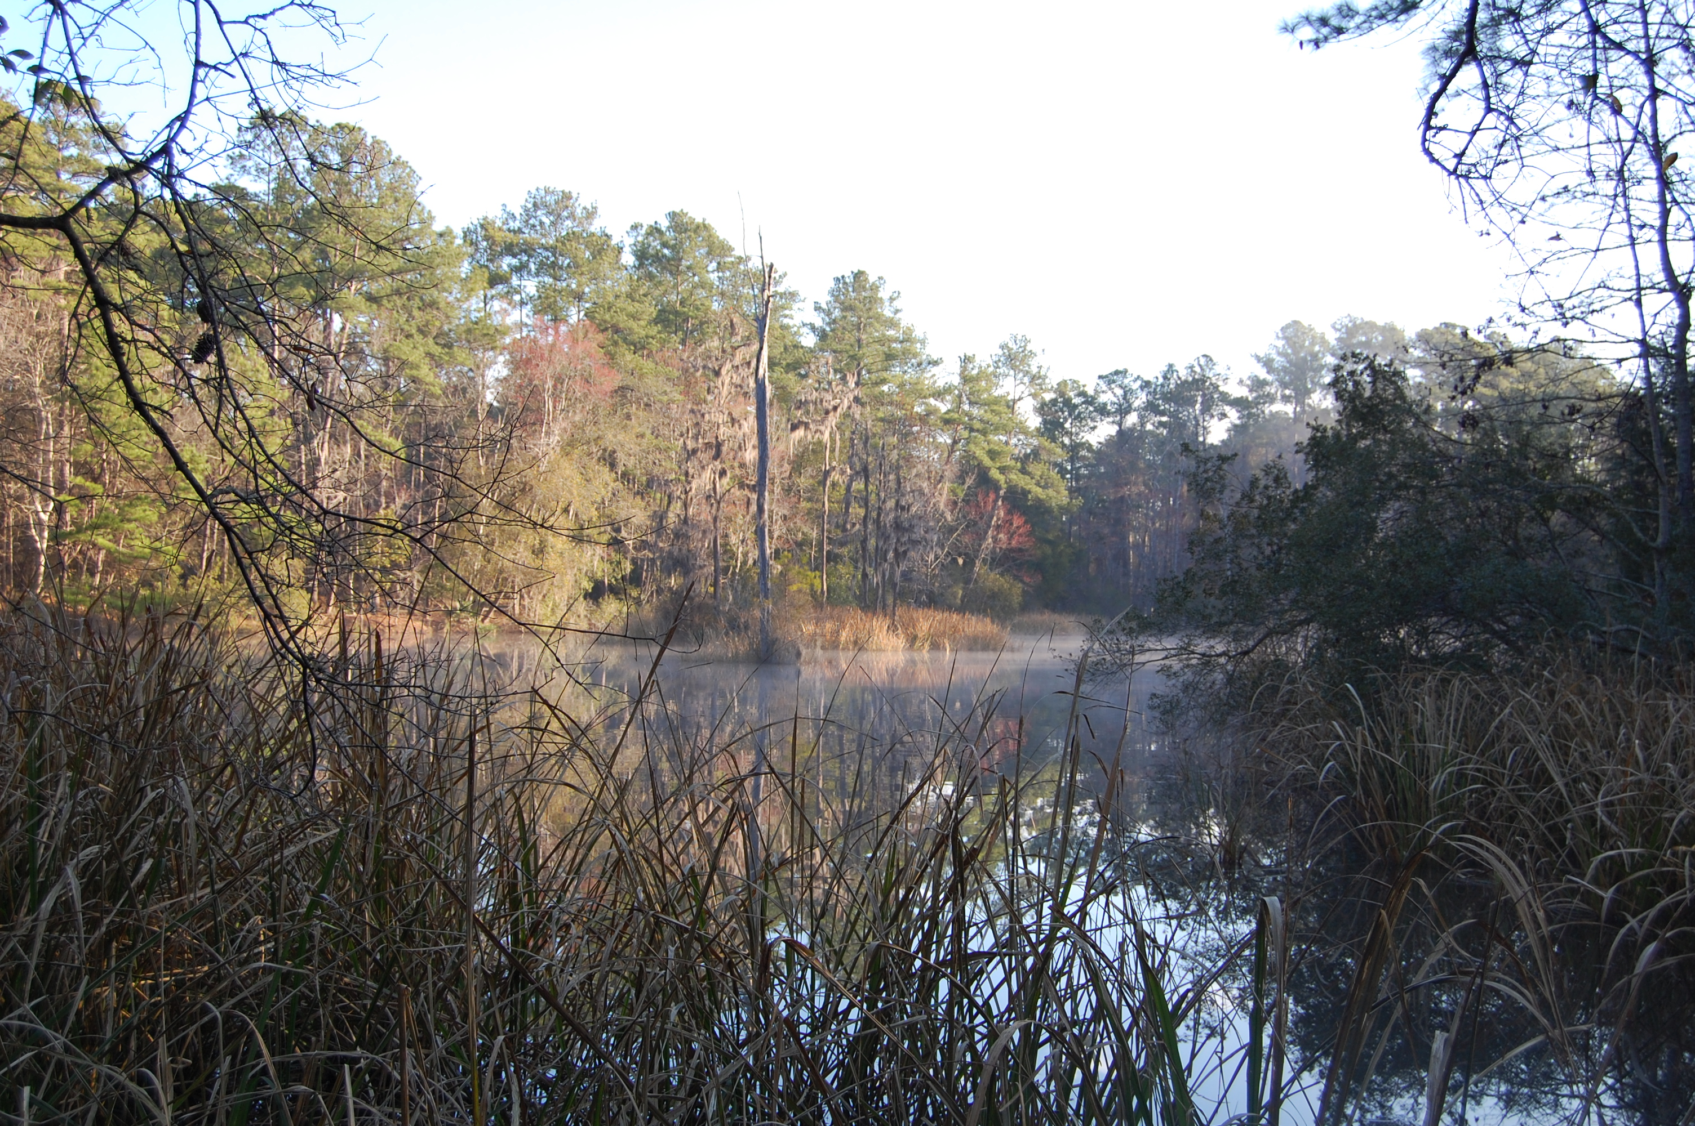
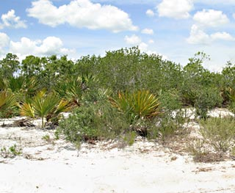
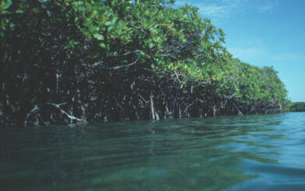
Florida Ecoregions
Southeastern Plain
Southern Coastal Plain
Southern Florida Coastal Plain
~4,100 vascular plant species
Notes:
Florida has a large diverse vascular flora that reflects a number of ecoregions due to differences in GEOLOGY, PHYSIOGRAPHY, VEGETATION, CLIMATE, SOILS, LAND USE, WILDLIFE, HYDROLOGY

Slide 14
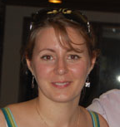
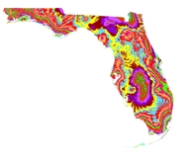
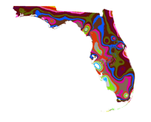
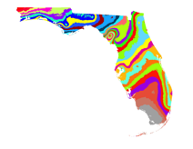
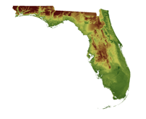
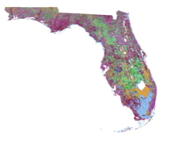
Modeling the Distribution of Species
Location information from herbarium labels
Environmental data:
Temperature, precipitation, soil, etc.
Software to model the range of each species
For Florida plants:
~2700 plant species (of 4100 species)
Charlotte
Germain-Aubrey
Notes:
We used specimen data from the herbaria of UF, FSU, and U of S Florida (>500,000 specimens) to map the distribution of >2700 species. We then used software for ecological niche modeling of each species based on environmental features, such as temperature, precipitation, soil type, etc. Much of this work was led by a former postdoc….

Slide 15
Modeling the Distribution of Species: Present
Notes:
As you know, the label data on these specimens is critical information---this allows us to map locations of the plants of florida

Slide 16
Modeling the Distribution of Species: Present
Notes:
To model present distributioins--We divided florida in to over 8000 pixels (red dot) –we could reconstruct the vascular plant occupancy within each pixel based on niche models—as you have been doing today

Slide 17
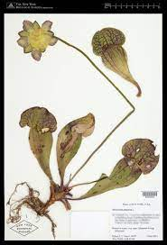
Modeling the Distribution of Species: Present
Notes:
To model present distributioins--We divided florida in to over 8000 pixels (red dot) –we could reconstruct the vascular plant occupancy within each pixel based on niche models—as you have been doing today

Slide 18
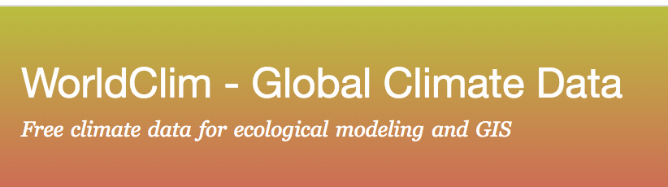
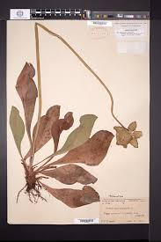
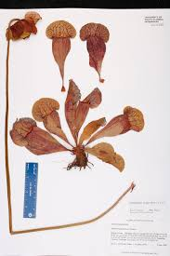
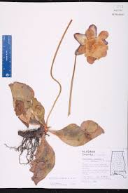
Modeling the Distribution of Species: Present
19 Bioclimatic variables
temperature
rainfall
Notes:
For environmental features, such as temperature, precipitation--We used WorldClim global climate data

Slide 19
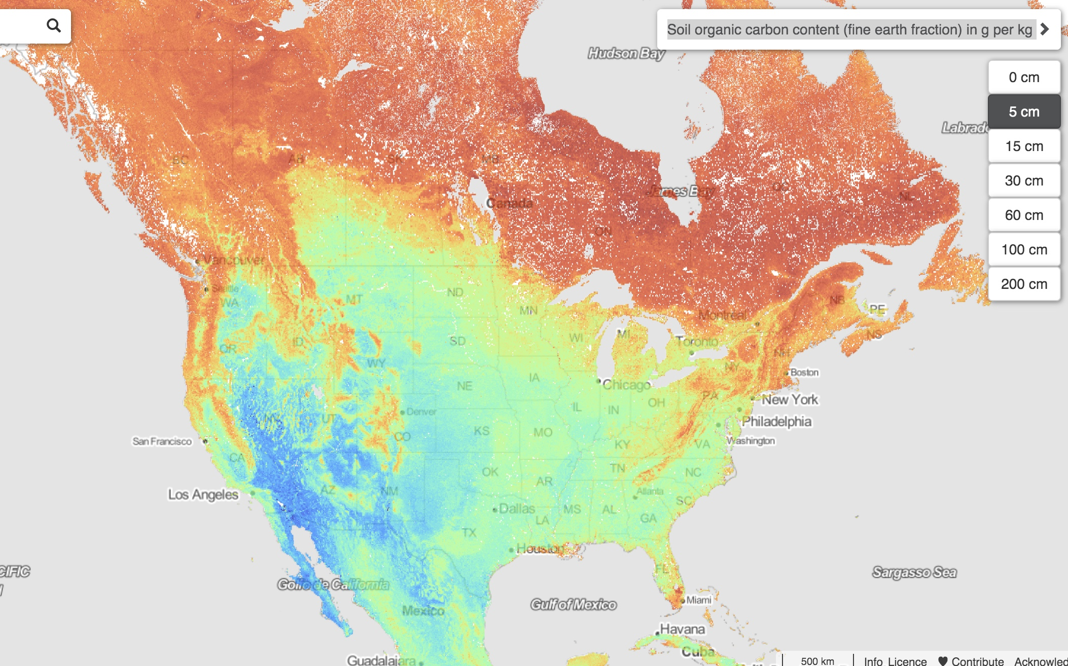
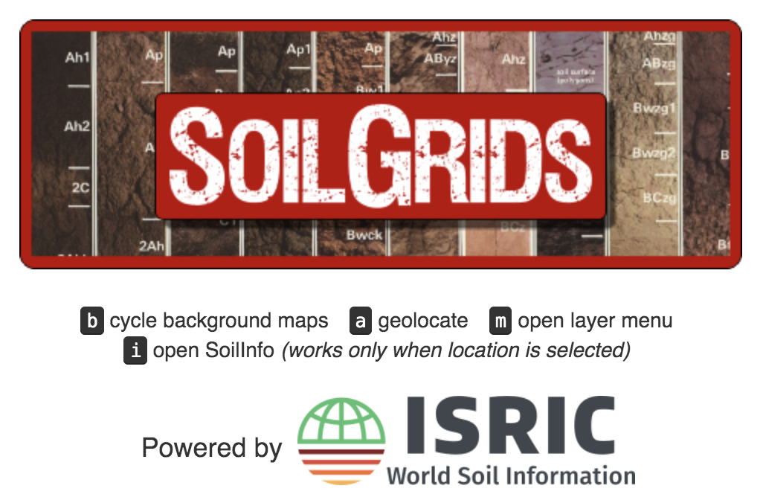
Modeling the Distribution of Species: Present
Global maps of soil properties at multiple depths
Notes:
For soil features (soil type) we used data from soil grids.

Slide 20
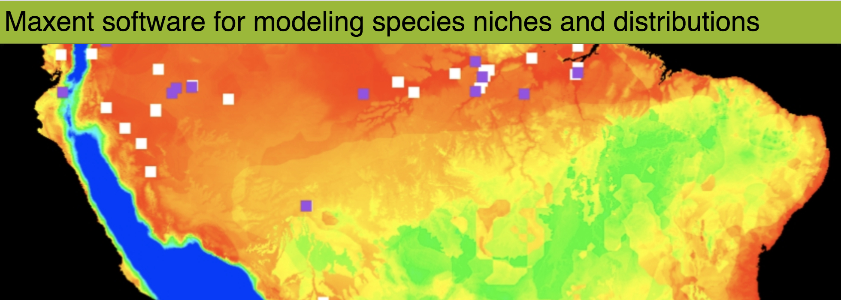
Modeling the Distribution of Species: Present
Notes:
We then used software for ecological niche modeling (Maxent) of each species based on these environmental features (temperature, precipitation, soil type, etc.) for over 2700 species as noted—THIS ALLOWED US TO MODEL THE PRESENT DISTRIBUTION

Slide 21
Applications of Ecological Niche Models
Estimate current distribution
Predict future distributions
Infer past distributions
Use as foundation for phylogenetic diversity studies
Niche of polyploid compared to its diploid progenitor(s)
Invasives--projections
Notes:
Let’s briefly review some of the applications of niche modeling. Highlighting the items here

Slide 22
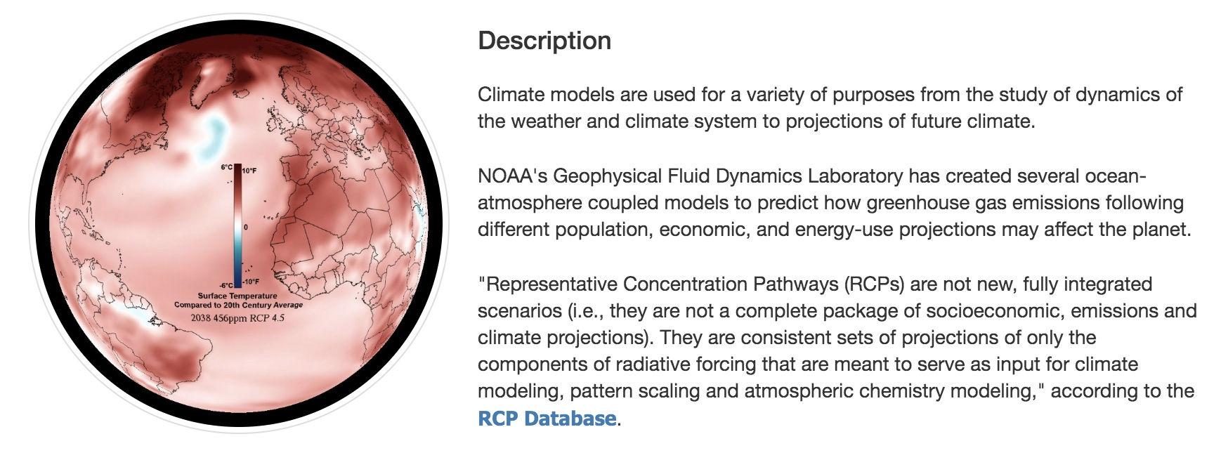
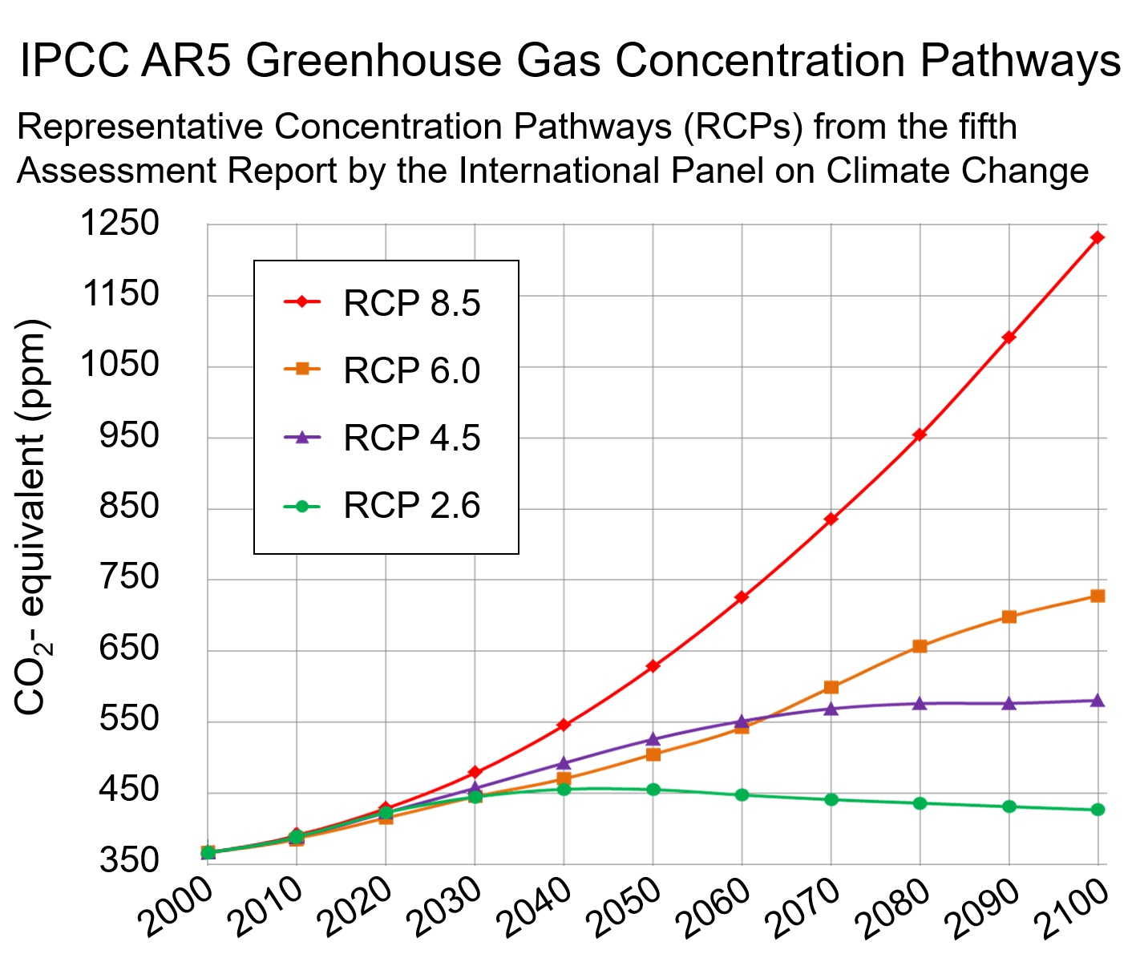

Modeling the Distribution of Species: Future
Representative Concentration Pathways: Models for Future Temperatures
Continues to rise – 3.7 C
Peak in 2060 – 2.2 C
Peak in 2040 – 1.8 C
Peak in 2020 – 1 C
Notes:
To model the future distributions – we relied on the Intergovernmental Panel on Climate Change 5th Assessment Report for RCPs (representative gas concentration pathways) – to give models for future temps. Different putative projections are shown here. These vary from a best-case scenario – that greenhouse gas concentrations peaked in 2020 and will result in a 1 degree C increase in global temps by 2100 – to a worst-case scenario in which greenhouse gas concentrations increase unchecked and will result in a 3.7 degree C temperature increase.
NOTE: ADDITIONAL RCPs HAVE ALSO BEEN DEVELOPED, BETWEEN THE 4 LISTED HERE.

Slide 23
Modeling the Distribution of Species: Future
Representative Concentration Pathways: Models for Future Temperatures
Continues to rise – 3.7 C
Peak in 2060 – 2.2 C
Peak in 2040 – 1.8 C
Peak in 2020 – 1 C
Notes:
These future projected temps are also available via Worldclim

Slide 24
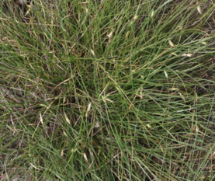
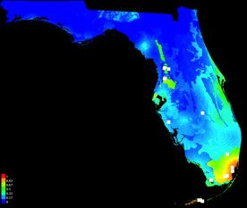
Response to Climate Change: Models for Present & Future
Abildgaardia ovata (flatspike sedge)
now
Notes:
Let’s look at a few projections---the warm colors indicate current suitable habitat in south florida -------looking next at 2050

Slide 25
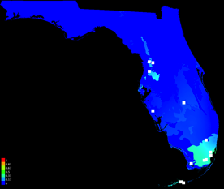
Response to Climate Change: Models for Present & Future
Abildgaardia ovata (flatspike sedge)
now
2050
Notes:
Now vs 2050…a clear loser to climate change scenarios….and this does not account for sea level rise

Slide 26
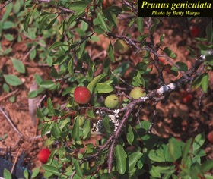
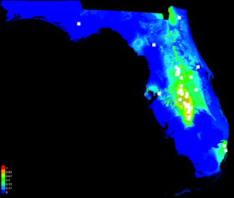
Response to Climate Change: Models for Present & Future
Abildgaardia ovata (flatspike sedge)
now
2050
Prunus geniculata (scrub plum)
now
Notes:
Let’s now look at the scrub plum which occurs in the dry soils of lake wales ridge (yes Florida has a mountain range)

Slide 27
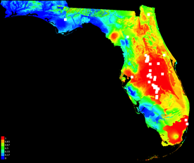
Response to Climate Change: Models for Present & Future
Abildgaardia ovata (flatspike sedge)
now
2050
Prunus geniculata (scrub plum)
now
2050
Notes:
So models suggest other species such as scrub plum may expand distributions---the potential for suitable habitat is there

Slide 28
Florida Plant Diversity: Now & 2050
Present
High
species diversity
Low
species diversity
Notes:
We can also make a state wide summary of present species diversity

Slide 29
Florida Plant Diversity: Now & 2050
Present
2050
High
species diversity
Gain of
species diversity
Low
species diversity
Loss of
species diversity
# spp 2050 - #spp now
Notes:
On the left is present species diversity. High and low. On the right in 2050 this actually shows gain in diversity and loss of species diversity. Via projections for 2050—there is a large drop of diversity in FL as some species move north, some south or just disappear

Slide 30
Applications of Ecological Niche Models
Estimate current distribution
Predict future distributions
Infer past distributions
Use as foundation for phylogenetic diversity studies
Niche of polyploid compared to its diploid progenitor(s)
Invasives--projections
Notes:
Let’s briefly review some of the applications of niche modeling. Highlighting the items here

Slide 31
Past Distribution: Scrub Mint Clade
Naranjo. 2020
Naranjo et al. unpubl.
Notes:
A good example of reconstruction of past distributions is seen in the scrub mint clade—work of Andre Naranjo

Slide 32
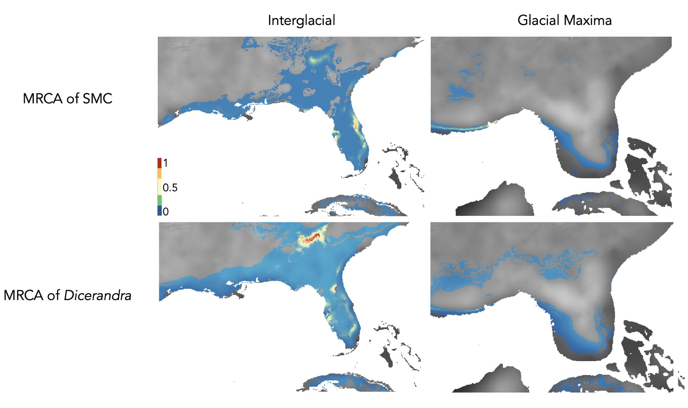

Past Distribution
PaleoClim:
paleoclim.org
Naranjo. 2020
Naranjo et al. unpubl.
Folk et al. 2018. American Naturalist
Notes:
Using niche models and Paleoclimate data Andre was able to reconstruct where clade members may have been in the past. This involves ancestral niche reconstruction—a phylogeny is used…a workflow we are implementing in Biotaphy (more later this afternoon)

Slide 33
Applications of Ecological Niche Models
Estimate current distribution
Predict future distributions
Infer past distributions
Use as foundation for phylogenetic diversity studies
Niche of polyploid compared to its diploid progenitor(s)
Invasives--projections
Notes:
Let’s briefly review some of the applications of niche modeling. Highlighting the items here

Slide 34
What to Protect?
Notes:
When we examine biiodiversity hotspots, such as those in California, the Appalachians, and Florida, how do we determine what species or areas to protect? Often decisions are based on the number of species present, or on a special so-called indicator species. But what if we used the power of the tree of life to aid conservation decisions?

Slide 35

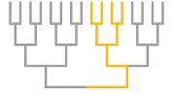
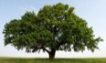
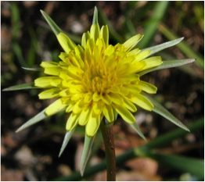
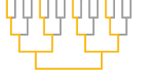
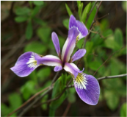
Phylogenetic Diversity:
How much of the Tree of Life is present in a geographic area?
Oaks
Vs.
Notes:
We can do this using something called phylogenetic diversity, instead of counting the number of species in an area, we can use their relationships to prioritize conservation decisions. How does this work?
PD measures how much of the tree of life is present in an area. Let’s say one area has 8 species, but they are all oaks. Now to oak specialists, or maybe event he squiirrels that eat the acorns, these oak species may seem different. But to most of us, and in relation to the rest of the Tree of Life, these species are all very similar. Another area also has 8 species, but they are much more diverse and cover more of the Tree of Life. This second area would have higher PD and might be a better option for conservation because more of the tree would be represented.

Slide 36
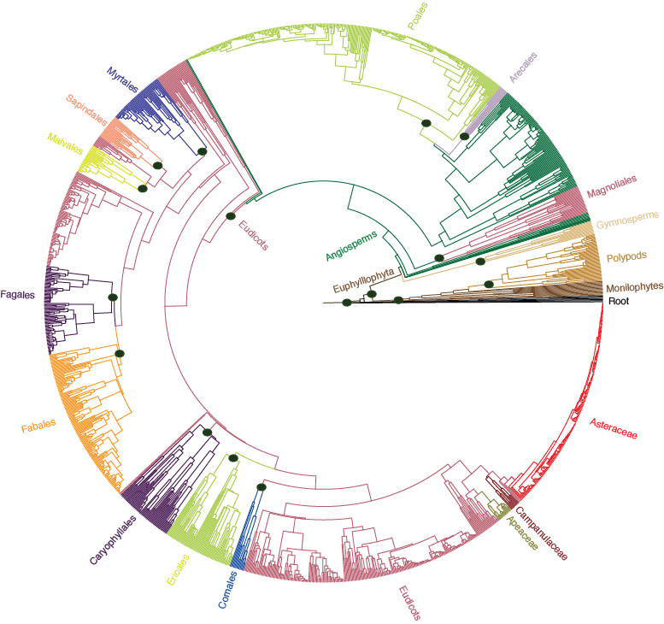
Phylogenetic Diversity
Florida Plant Phylogeny
Allen et al. 2019
Notes:
To measure PD, we need a tree – this is a phylogeny of Florida plants – and

Slide 37
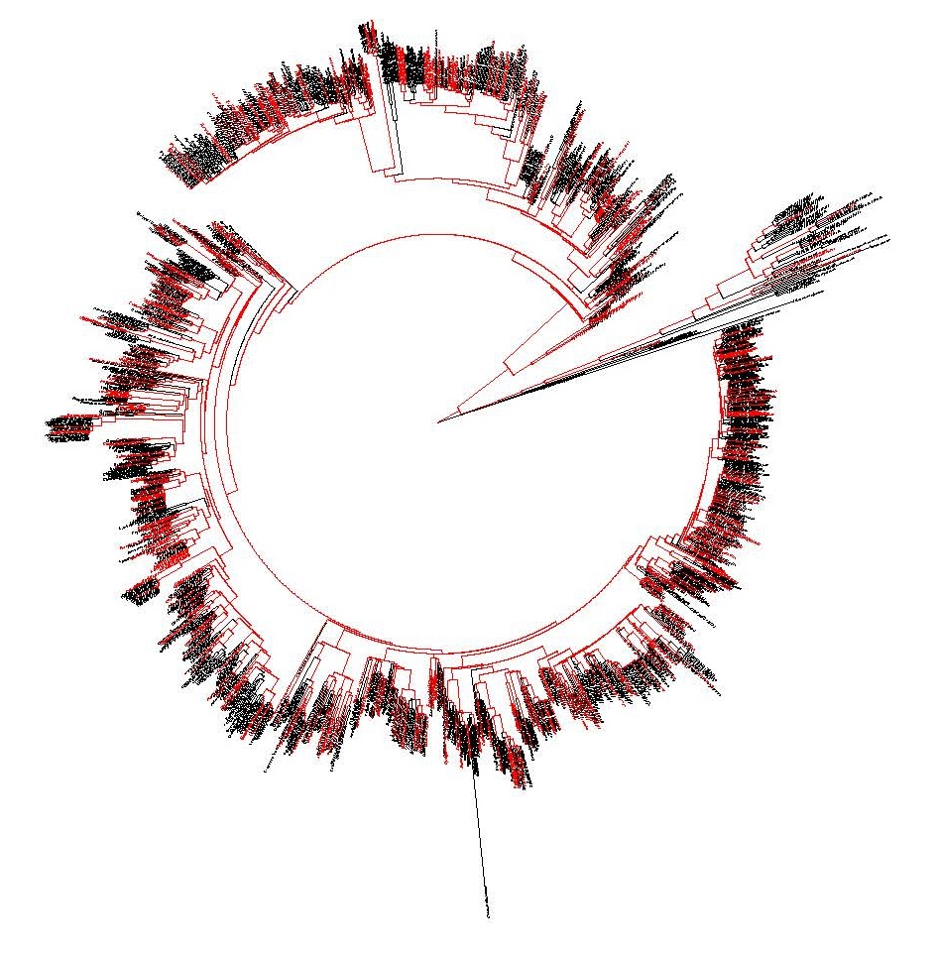
Computing Phylogenetic Diversity
Phylogenetic Diversity:
How much of the Tree of Life is present in a geographic area?
Species A
Species B
Species C
Species D
Species E
…
8,045 pixels/communities
16 km² per pixel
Notes:
Sticking with Florida let us return to the map of the state and the pixels I noted – we can also compute PD (phylogenetic diversity)—how much of the plant tree of life is present in an area (Florida). MORE ON THIS IN BIOTAPHY. To do this we built niche models for over 2700 species to build distributions; we built a phylogeny for the vasc plants of FL; and then asked how much of that tree of life is represented in each pixel….and that can then be summed across the entire state

Slide 38
Computing Phylogenetic Diversity
Phylogenetic Diversity:
How much of the Tree of Life is present in a geographic area?
Notes:
And here is that PD summary (present day) –dark green = high PD

Slide 39
Phylogenetic Diversity: China
Low PD
High PD
Lu et al. 2018. Nature

Slide 40
Applications of Ecological Niche Models
Estimate current distribution
Predict future distributions
Infer past distributions
Use as foundation for phylogenetic diversity studies
Niche of polyploid compared to its diploid progenitor(s)
Invasives--projections
Notes:
Let’s briefly review some of the applications of niche modeling. Highlighting the items here

Slide 41


Niche Evolution in Allopolyploids
Niche Intermediacy
Niche Expansion
Blaine
Marchant
Species A
2n
Species A
2n
Species C
4n
Species C
4n
Species B
2n
Species B
2n
Niche Contraction
Niche Novelty
Species A
2n
Species A
2n
Species C
4n
Species C
4n
Species B
2n
Species B
2n
Marchant et al. 2016. New Phytologist
Notes:
Moving on--another example involves polyploidy and the work of Blaine.. Polyploids following formation in theory may exhibit…

Slide 42
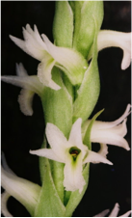
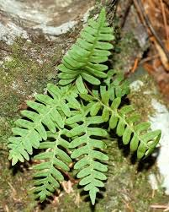
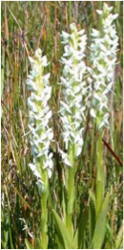










+
Polyploidy
Asplenium rhizophyllum
(2n)
Asplenium montanum
(2n)
Asplenium pinnatifidum
(4n)
Notes:
He investigated this--The plants examined

Slide 43

Niche Evolution in Allopolyploids
Niche Intermediacy
Breadth: Parent < Polyploid < Parent
Overlap: Polyploid > 0.3
Blaine
Marchant
Dryopteris celsa
Nickrent, D.L. et al. 2006 onwards. PhytoImages.
http://www.phytoimages.siu.edu
Marchant et al. 2016. New Phytologist
Notes:
Here is an example of niche intermediacy—parents on either side—allopolyploid in the middle

Slide 44





Niche Evolution in Allopolyploids
13 allopolyploids & parents
Niche intermediacy: 8
Niche contraction: 2
Niche expansion: 2
Niche novelty: 1
More cases are needed!
Blaine
Marchant
+
Polyploidy
Asplenium rhizophyllum
(2n)
Marchant et al. 2016. New Phytologist
Notes:
Here is a summary—most showed intermediacy, but not all…more work is needed

Slide 45





Niche Evolution in Autopolyploids
Tolmiea menziesii
Galax urceolata
Notes:
Finally, these approaches have been applied to autopolyploids and their diploid parents. Shelly whom you have heard from today did this as an undergrad!

Slide 46
Applications of Ecological Niche Models
Estimate current distribution
Predict future distributions
Infer past distributions
Use as foundation for phylogenetic diversity studies
Niche of polyploid compared to its diploid progenitor(s)
Invasives--projections
Notes:
Let’s briefly review some of the applications of niche modeling. Highlighting the items here

Slide 47
Potential Distributional Shifts Under Climate Change Models
Anson Wang
Ailanthus altissima
Casuarina equisetifolia
Centaurea stoebe ssp. micranthos Dioscorea bulbifera
Lantana camara
Schinus terebinthifolia
Wang, A., A. Melton et al. 2022. Plant Diversity.
Notes:
Lastly here is another undergrad in the lab who has been using niche models to project future distribution of a number of invasives— several different future years are shown here. Anson is here next to his poster on the work. This paper was just accepted for publication

